Slide 1
Blacklingual Discord
Daily Routine + Reflexive Verbs

Slide 2
First Things First
To talk about your routine, I first need to explain what a reflexive verb is.

Slide 3
What is a reflexive verb?
Reflexive verbs are used to show that the subject (whoever we’re talking about) does an action to themselves.

Slide 4
What is a reflexive verb?
Reflexive verbs are used to show that the subject (whoever we’re talking about) does an action to themselves.
Note: It also has a couple other uses but we aint talking about that in this lesson.

Slide 5
How do I know if a verb is reflexive? (UNconjugated)

Slide 6
How do I know if a verb is reflexive? (UNconjugated)
If the verb is not conjugated yet, you can tell it is reflexive because it will have “se” at the end of it:

Slide 7
How do I know if a verb is reflexive? (UNconjugated)
If the verb is not conjugated yet, you can tell it is reflexive because it will have “se” at the end of it:
Levantarse

Slide 8
How do I know if a verb is reflexive? (UNconjugated)
If the verb is not conjugated yet, you can tell it is reflexive because it will have “se” at the end of it:
Levantarse
We know it is reflexive because all verbs end in AR, ER, or IR. So this extra little ending of se tells us it’s reflexive.

Slide 9
Regular VS Reflexive Verbs

Slide 10
Regular VS Reflexive Verbs
NOT reflexive | Reflexive

Slide 11
Regular VS Reflexive Verbs
NOT reflexive | Reflexive
Levantar = to lift Example: Levantar pesos = to lift weights

Slide 12
Regular VS Reflexive Verbs
NOT reflexive | Reflexive
Levantar = to lift Example: Levantar pesos = to lift weights | Levantarse = to lift oneself / to get up Example: Levantarse de la cama = to lift oneself out of bed / get out of bed

Slide 13
How do I know if a verb is reflexive? (Conjugated)

Slide 14
How do I know if a verb is reflexive? (Conjugated)
If a verb is conjugated, you can tell because it’ll use a reflexive pronoun that matches the subject.

Slide 15
How do I know if a verb is reflexive? (Conjugated)
If a verb is conjugated, you can tell because it’ll use a reflexive pronoun that matches the subject.
The reflexive pronouns are

Slide 16
How do I know if a verb is reflexive? (Conjugated)
If a verb is conjugated, you can tell because it’ll use a reflexive pronoun that matches the subject.
The reflexive pronouns are
me (myself) - this is pronounced ¨meh¨ not like the English “me” (that’s “mi”)

Slide 17
How do I know if a verb is reflexive? (Conjugated)
If a verb is conjugated, you can tell because it’ll use a reflexive pronoun that matches the subject.
The reflexive pronouns are
me (myself)
te (yourself)

Slide 18
How do I know if a verb is reflexive? (Conjugated)
If a verb is conjugated, you can tell because it’ll use a reflexive pronoun that matches the subject.
The reflexive pronouns are
me (myself)
te (yourself)
se (himself/herself/itself/yourself for usted)

Slide 19
How do I know if a verb is reflexive? (Conjugated)
If a verb is conjugated, you can tell because it’ll use a reflexive pronoun that matches the subject.
The reflexive pronouns are
me (myself)
te (yourself)
se (himself/herself/itself/yourself for usted)
nos (ourselves)

Slide 20
How do I know if a verb is reflexive? (Conjugated)
If a verb is conjugated, you can tell because it’ll use a reflexive pronoun that matches the subject.
The reflexive pronouns are
me (myself)
te (yourself)
se (himself/herself/itself/yourself for usted)
nos (ourselves)
se (themselves/yallselves)

Slide 21
Example of Conjugated Reflexive Verb

Slide 22
Example of Conjugated Reflexive Verb
Let’s stick with levantarse (to get oneself up)

Slide 23
Example of Conjugated Reflexive Verb
Let’s stick with levantarse (to get oneself up)
Me levanto a las ocho (I get myself up at 8)

Slide 24
Example of Conjugated Reflexive Verb
Let’s stick with levantarse (to get oneself up)
Me levanto a las ocho (I get myself up at 8)
¿A que hora te levantas? (At what time do you get up?)

Slide 25
Example of Conjugated Reflexive Verb
Let’s stick with levantarse (to get oneself up)
Me levanto a las ocho (I get myself up at 8)
¿A que hora te levantas? (At what time do you get up?)
Notice that in both of these, there is a pronoun that matches the verb.

Slide 26
Example of Conjugated Reflexive Verb
Let’s stick with levantarse (to get oneself up)
Me levanto a las ocho (I get myself up at 8)
¿A que hora te levantas? (At what time do you get up?)
Notice that in both of these, there is a pronoun that matches the verb.
Me = yo
Levanto = yo

Slide 27
Example of Conjugated Reflexive Verb
Let’s stick with levantarse (to get oneself up)
Me levanto a las ocho (I get myself up at 8)
¿A que hora te levantas? (At what time do you get up?)
Notice that in both of these, there is a pronoun that matches the verb.
Me = yo
Levanto = yo
Same person. So this is reflexive

Slide 28
NOW let’s talk about your routine

Slide 29
NOW let’s talk about your routine
I’m gonna give you a bunch of verbs and examples to help you build your daily routine

Slide 30
NOW let’s talk about your routine
I’m gonna give you a bunch of verbs and examples to help you build your daily routine
Can you tell which ones are reflexive and which ones aren’t?

Slide 31

Morning
Despertarse - To wake up
  Normalmente me despierto a las 6:00 de la mañana. (I normally wake up at 06:00 in the morning.)
Levantarse - To get up
  Me levanto a las 06:30 de la mañana. (I get up at 06:30 in the morning.)

Slide 32
Getting Ready
Cepillarse los dientes - To brush one’s teeth
  Me cepillo los dientes luego de levantarme (She brushes her teeth after getting up.)
Hacer la cama - To make the bed
  Yo nunca hago la cama en la mañana. (I never make my bed in the morning.
Ducharse - To take a shower
  Me ducho en la mañana (I shower in the morning.)
Vestirse - To get dressed
  Siempre me visto luego de ducharme (I always get dressed after taking a shower.)
Alimentar al perro / al gato / a los animales - To feed the dog/cat/animals
  Tengo que alimentar a los perros (I have to feed the animals)

Slide 33
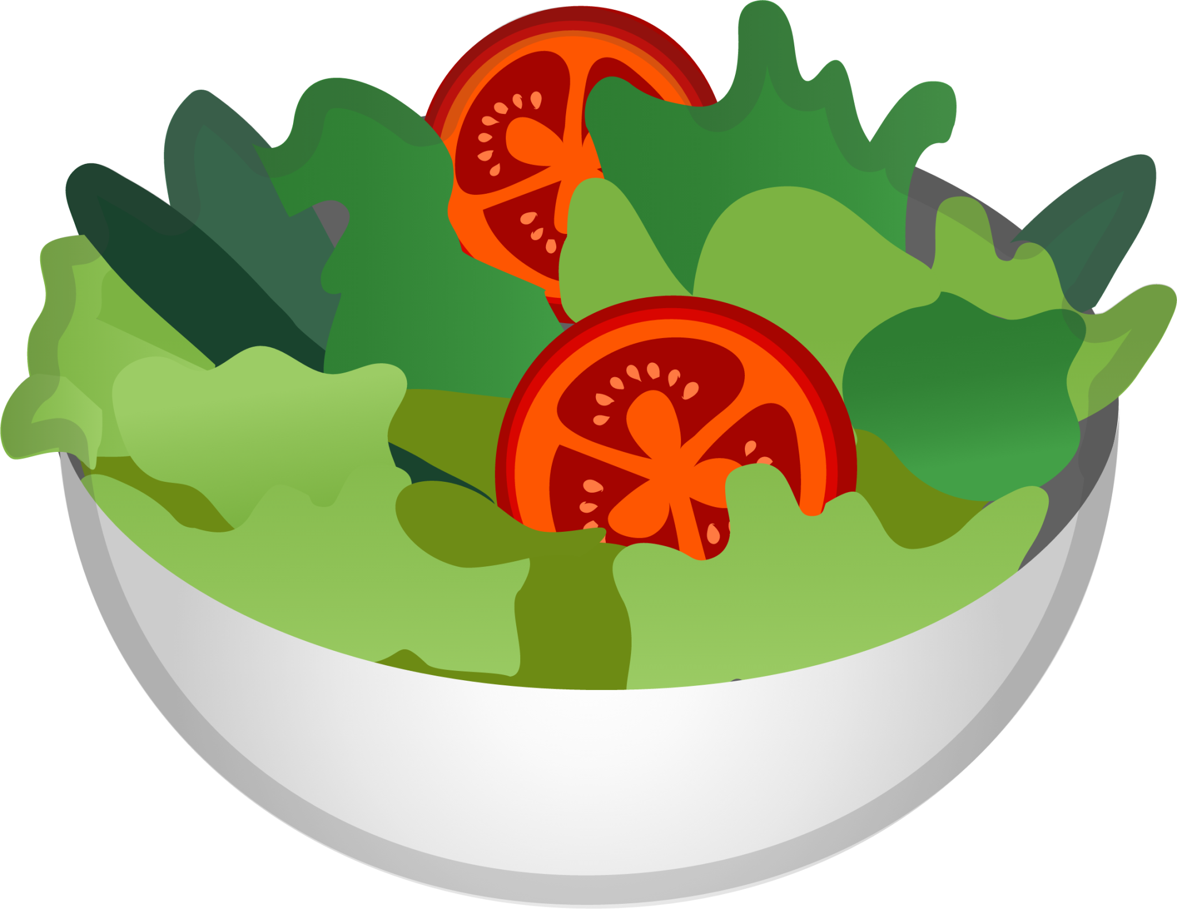
Eating
Preparar (la comida) - To prepare / make food
  Preparo el desayuno antes de irme a trabajar (I make breakfast before going to work.)
Desayunar - To have/eat breakfast
  Siempre desayuno en mi casa (I always ¨breakfast¨ / eat breakfast at home.)
Almorzar - To have/eat lunch
  Almuerzo con ustedes (I ¨lunch¨ / eat lunch with yall)
Cenar - To have/eat dinner
  Ceno pizza (I ¨dinner¨ pizza / I eat pizza for dinner.)
Comer - To eat
  Como el desayuno a las nueve (I eat breakfast at 9)
Beber OR Tomar - To drink
  Tomo café por la mañana OR bebo café por la mañana (I drink coffee in the morning)

Slide 34
Working
Comenzar a trabajar - To start work
  Comienzo a trabajar a las 9:00 am. (I start work at 9:00 am.)
Salir de trabajo - To get off work
  Salgo del trabajo a las 5:00 de la tarde. (I get off work at 5:00 in the afternoon)
Trabajar - To work
  Trabajo de 9 a 5. (I work from 9 to 5.)
Comenzar clases - To start classes
  Comienzo clases a las 7:45 am todos los días. (I start classes at 7:45 am every day.)
Llegar a casa - To get / arrive home
  Llego a casa a las 8:00 de noche. (I get home at 8:00 noche.)

Slide 35
Free Time
Estudiar - To study
  Estudio español todos los sábados. (I study Spanish every Saturday.)
Ver la tele/television - To watch TV
  Veo la tele todas las tardes. (I watch TV every afternoon.)
Escuchar música - To listen to music
  Escucho música cuando estoy triste. (I listen to music when I’m sad.)
Revisar las redes sociales - To check one’s social media platforms
  Reviso mi TikTok - I check my TikTok
  Siempre estoy revisando mi Facebook. – I’m always checking Facebook.
Hacer ejercicios - To exercise (literally ¨to do exercise¨)
  Hago ejercicios en el gimnasio (I exercise at the gym)

Slide 36
Night
Acostarse - To go to bed
  Siempre me acuesto a las diez cada noche. (I always go to bed at 10 each night)
Ir(se) a dormir - To go to bed
  Me voy a dormir temprano. (I´m going to bed early.)
Dormir(se) - To fall asleep
  Me duermo muy rápido. (I fall asleep very fast.)

Slide 37

Frequency
Normalmente – Normally
  Normalmente desayuno antes de salir de la casa. (I normally have breakfast before leaving the house.)
Usualmente - Usually
  Yo usualmente saco a mi perro en las mañanas. (I usually take out my dog in the morning.)
A menudo - Often
  ¿Vienes por acá a menudo? – No, de hecho, no. (Do you come around often? No, actually, I don’t.)
Frecuentemente – Frequently
  Ella va al gimnasio frecuentemente. (She goes to the gym frequently.)
Regularmente – Regularly
  Mi hermano limpia su habitación regularmente. (My brother cleans up his room regularly.)
A veces - Sometimes
  A veces voy a correr. (I sometimes go for a run.)
Pocas veces - Rarely
  Yo visito a mis primos pocas veces. (I rarely visit my cousins.)
Todos los días - Every day
  Yo voy a la escuela todos los días. (I go to school every day.)
Nunca - Never
  Yo nunca hago ejercicio (I never do exercise.)
Siempre - Always
  Yo siempre me quedo en casa los fines de semana. (I always stay in on the weekend.)

Slide 38
Practice
To help you practice to earn your badge, document your daily routine and have conversations with people in here in the community.
Include both reflexive and regular verbs too!

